Slide 1

MCHEZOPESA LTD
FOOTBALL

Slide 2
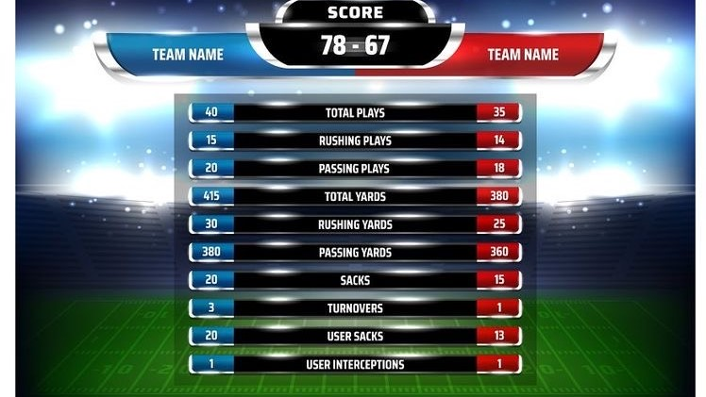
SCORE PREDICTOR SYSTEM

Slide 3

TEAM
FRED MWASHIMBA
ESTHER NYOKABI
CELESTINE KARIMI
URBANUS KATHITU
ANTHONY NJOYA

Slide 4

PROJECT PLAN
BUSINESS UNDERSTANDING
DATA CLEANING AND PREPARATION
DATA ANALYSIS
MODELLING
CONCLUSION
RECOMMENDATIONS

Slide 5

CONTEXT
The FIFA Men's World Ranking is a ranking system for men's national teams in association football. The teams of the men's member nations of FIFA, football's world governing body, are ranked based on their game results with the most successful teams being ranked highest. The rankings were introduced in December 1992.
A points system is used, with points being awarded based on the results of all FIFA-recognized full international matches. It is called the Elo rating system.
The study is meant to predict the number of scores made by both the away team and home teams.

Slide 6

OBJECTIVE
To predict the results of a game between team 1 and team 2 for Mchezopesa LTD, based on who's home and who's away, and on whether or not the game is friendly.

Slide 7
ANALYSIS
We need the model to predict games at an industry-accepted accuracy level (80% at least). In the context of goals, that means our testing results should not vary from the training data by more than +/- 1 goal.
We used polynomial approach and logistic approach to predict the results.
Polynomial Approach – The input in this case was Home Team, Away Team and the Tournament Type. In this approach the following was trained:
a) Rank of home team. b) Rank of away team. c) Tournament.
Logistic regression is the appropriate regression analysis to conduct when the dependent variable is binary. Like all regression analyses, the logistic regression is a predictive analysis.
Logistic regression was used to describe data and to explain the relationship between one dependent binary variable and one or more nominal, ordinal, interval or ratio-level independent variables.

Slide 8

CONCLUSION
Our Model in Polynomial approach did best when our degree is 1 the higher it went the error became higher.
Cross Validation model number 4 is the best for predicting our away score
The accuracy test for Logistic Regression Approach shows that our algorithm is approximately 31.15% accurate in predicting the match status of the home team.

Slide 9


RECOMMENDATIONS
The first solution brought almost a perfect model which means that there could be changes that could be made. We could have maybe added the weighted points and previous points. Also, some factors such as injury on players should have been included in the dataset and players being given a red card and benched can affect the outcome of their next 2 games.

